Slide 1
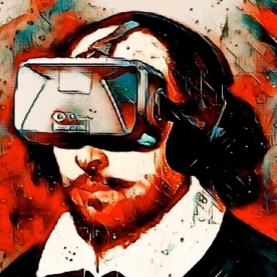
eXtended Reality
Team Members: Diego Tapia Araiza, Joren Cruz, Daniel Wang
Overseen by: Professor Aveek Duta

Slide 2
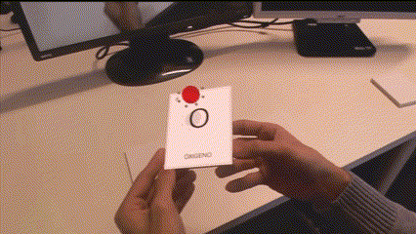
QR Codes

Slide 3
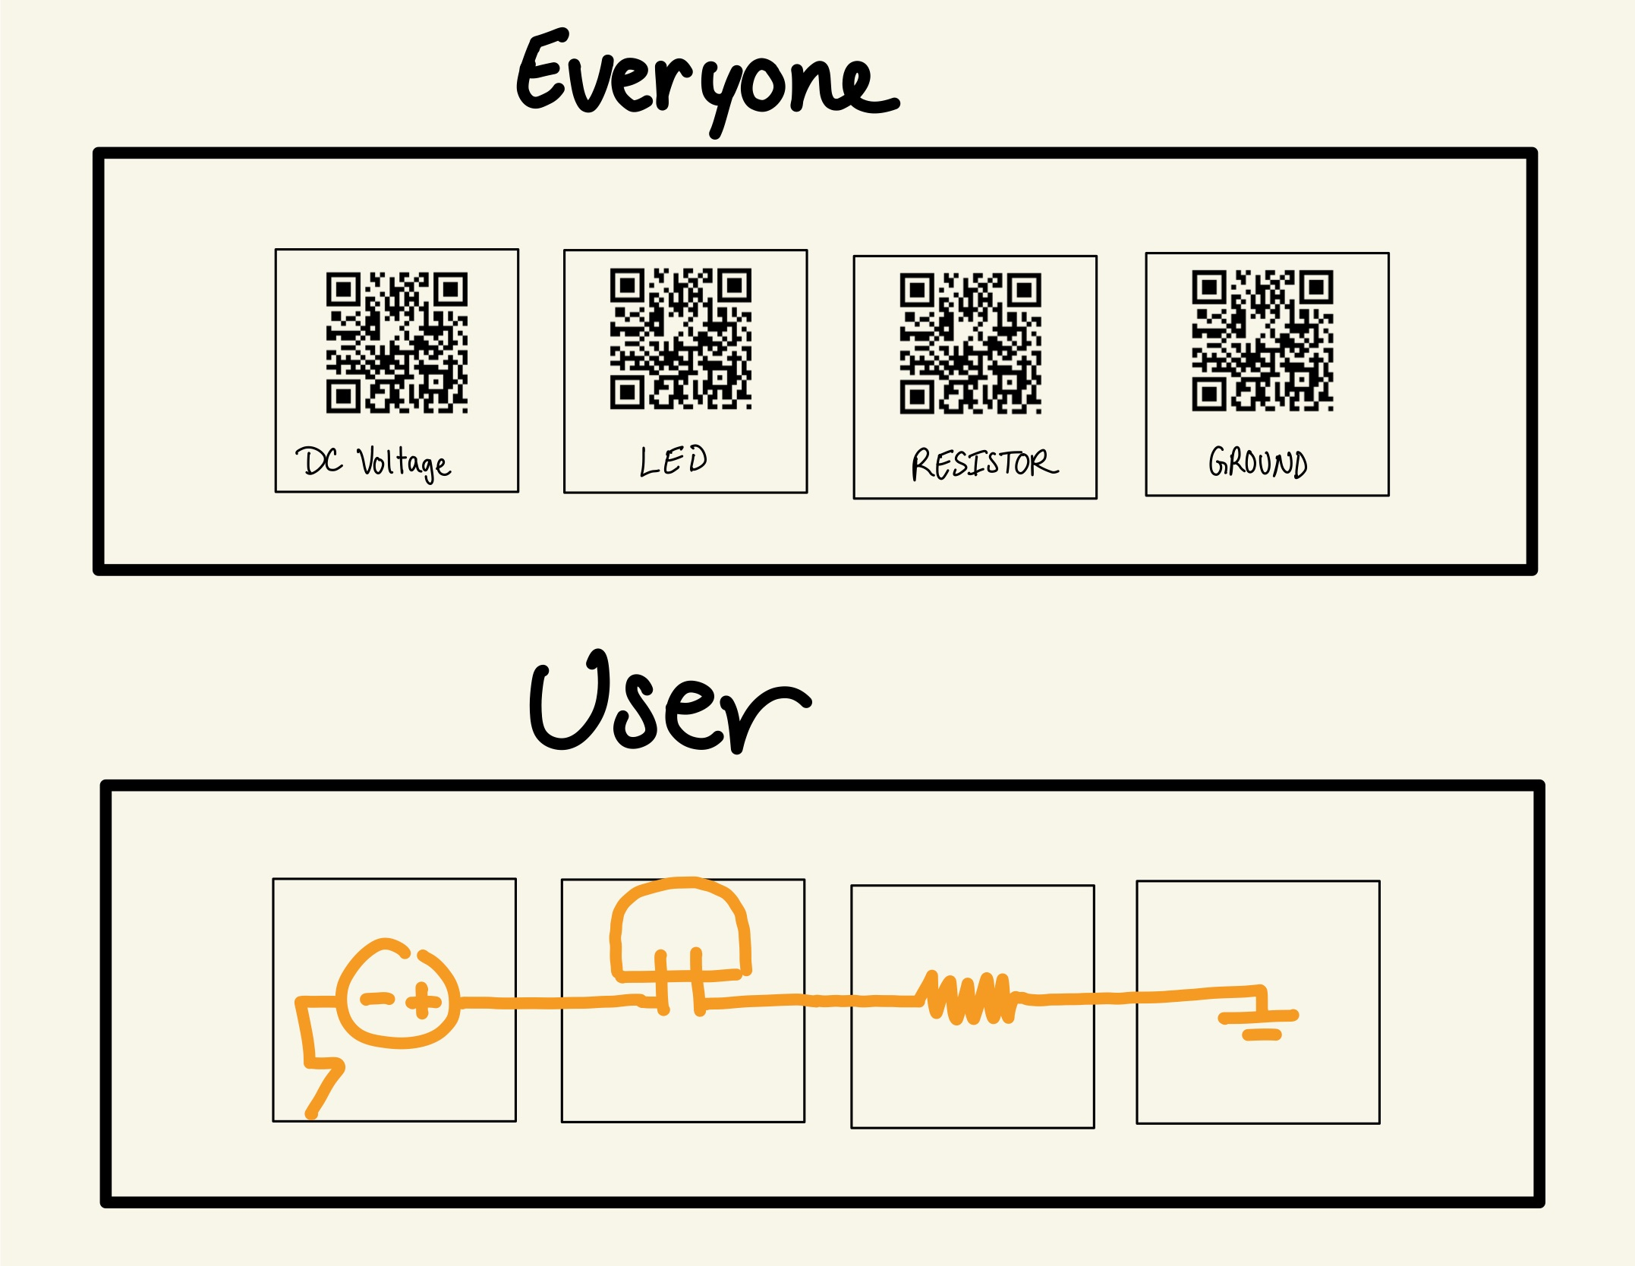
QR Code
Foundation
Testing Environment
User Interactive
Limited Uses
Accessibility (Phones)
AR with MR capabilities

Slide 4
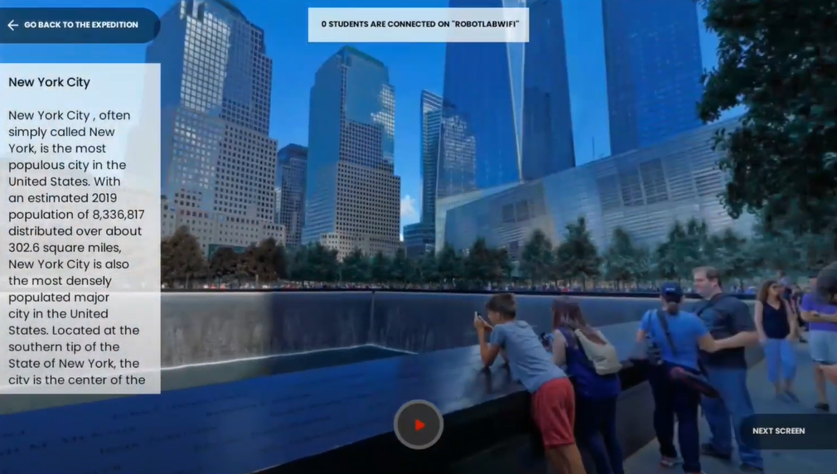
Virtual Interactive Learning

Slide 5
Virtual Interactive Learning
Interactive "Textbook/Labs"
Entertaining
Lesson Based
"Learn at your own pace"
AR-Based
Could use Smart Glasses or possibly a smartphone

Slide 6
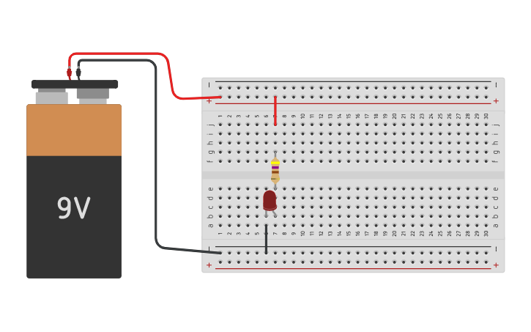
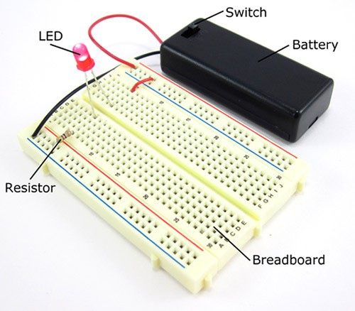
Digital-Physical Integration

Slide 7
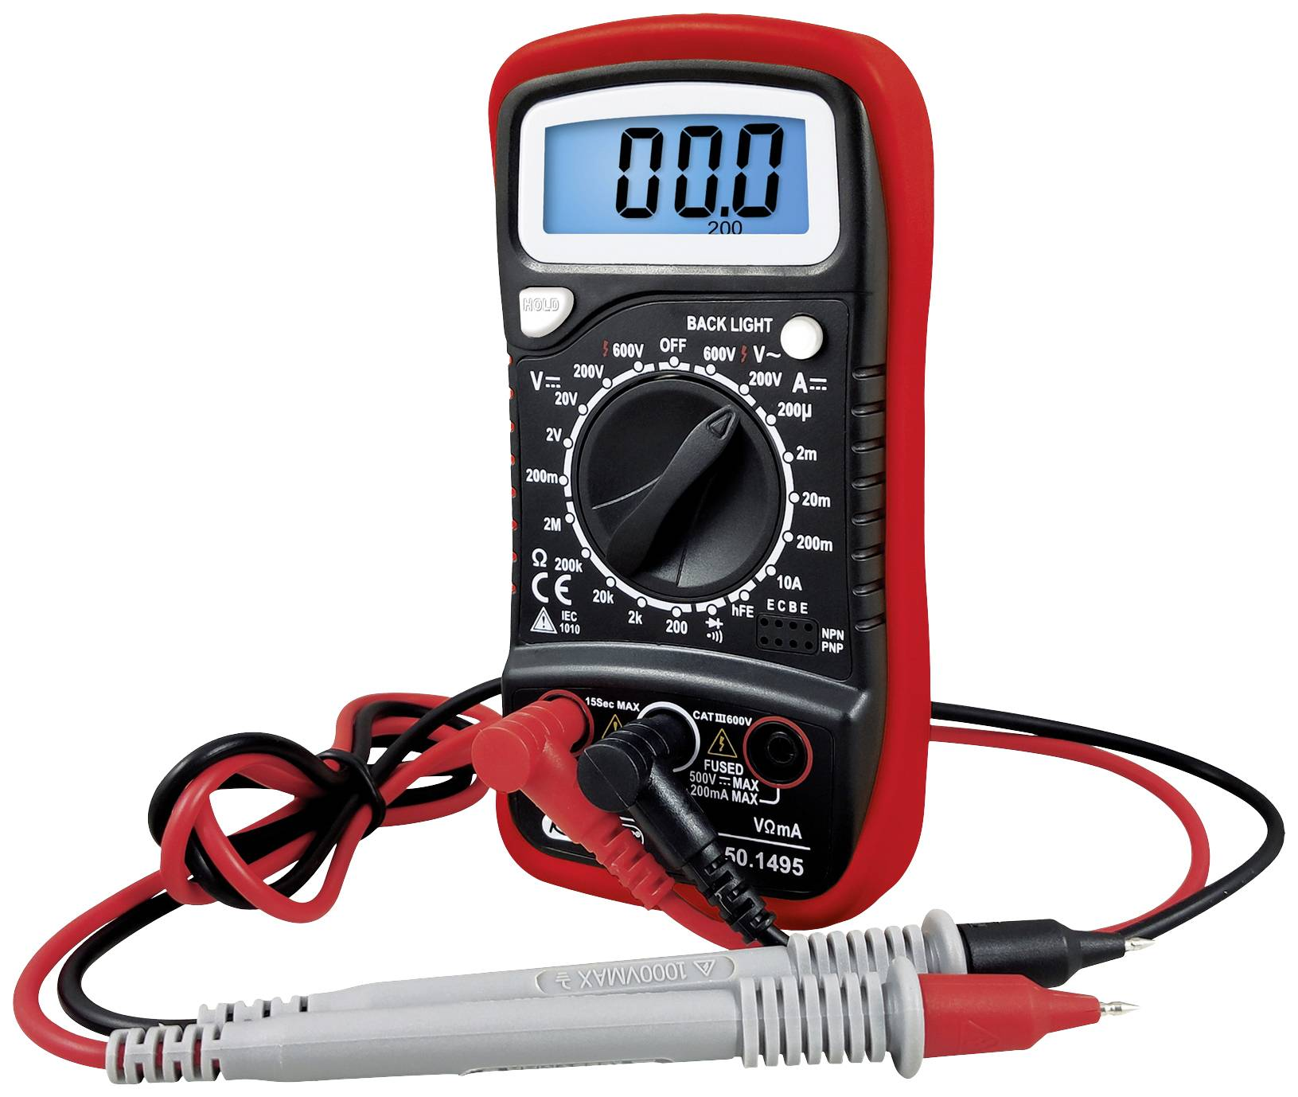
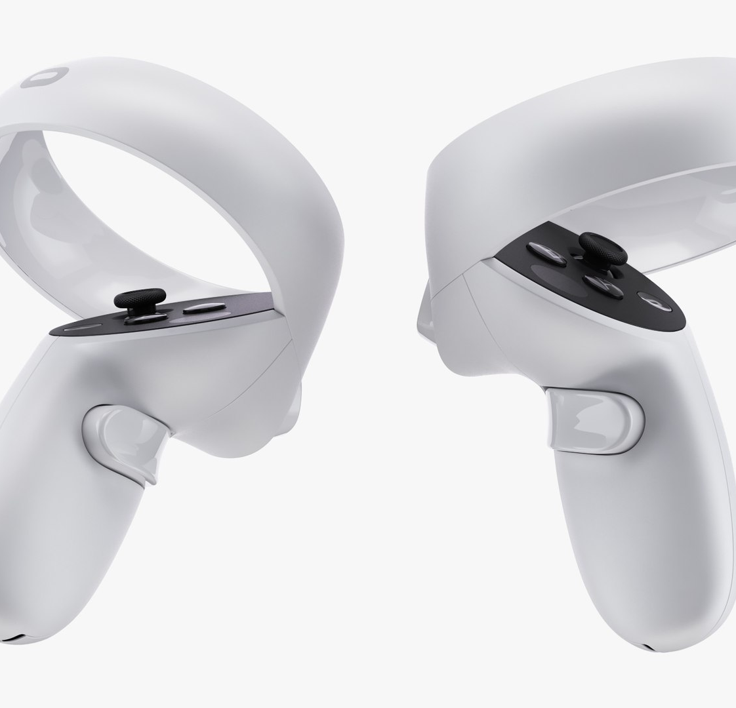
Digital-Physical Integration
Building a circuit schematic in a physical environment and exporting to observe virtually
"VR LTSpice" or any type of simulation
Circuit can be measured and tested in a variety of analysis types
Provides a safe environment

